Slide 1
Coding Standard & Code Review
Milan Vukoje
www.vukoje.net

Slide 2

Soprex
SkfOffice2
SkfOffice3
Big5
Quality oriented
We are hiring…

Slide 3
Themes
Coding Standard
Code Review
Tools

Slide 4
Coding Standard
In a complex program, architectural guidelines give the program structural balance and construction guidelines provide low-level harmony.
Without a unifying discipline, your creation will be jumble of sloppy variations in style.
One key to successful programming is avoiding arbitrary variations so that your brain can be free to focus on the variations that are really needed.
-- Steve McConell

Slide 5
CS Advantages
Unified code
Faster code understanding/modifying
Easier “code smell” identification
Cleaner API
Avoiding “genius” solutions (KISS)
Reducing chances for bugs
Real working framework
Notes:
Galvni ralog zasto je Outsourcing u Indiju propao

Slide 6

The Book
Framework Design Guidelines: Conventions, Idioms, and Patterns for Reusable .NET Libraries -- Krzysztof Cwalina and Brad Adams
Notes:
Rezultat visegodisnjih analiza
MS primenjuje za svoje timove
MS generisan kod nije po standardu

Slide 7
Soprex Coding Standard
Code Commenting
Naming
Code Layout
Type Design Guidelines
Member Design
Exception Management
Stored Procedures
.NET types usage
Notes:
Postavku smo izvukli iz knjige, pa smo dodavali pravila kako in nadjemo.

Slide 8
Available Tools
VS compiler warnings
Code Analysis
StyleCop
TFS check in policy
Performance issues
Notes:
Odlican help za CA
Suppressions
Great way to learn .NET
U buducnosti automatska modifikacija koda (od strane alata)

Slide 9
Coding Standard 1. Code Commenting
DO comment API.
DO NOT comment whole methods or method bodies. If some code is not used, it should be deleted.
DO comment complex methods, especially if/else statements.
Notes:
Lesevi u kodu

Slide 10
Coding Standard 2. Property Design
DO NOT provide set-only properties.
DO provide sensible default values for all properties.
DO NOT implement time consuming operations in properties.
Notes:
B5 bug
DateTime.Now treba da bude metod

Slide 11
Coding Standard 3. Collections
DO NOT use weakly typed collections in public APIs.
DO use ReadOnlyCollection<T> for properties representing read-only collections.
DO NOT return null values from collection properties or from methods returning collections
DO NOT return snapshots collections from properties
Notes:
. If there is no items for collections return empty c
. Properties should return live collections.ollection. This rule implies to DataTable type also.

Slide 12
Coding Standard 4. Event Design
DO use System.EventHandler<T>
DO use a return type of void for event handlers
DO NOT pass null as the event data ,pass EventArgs.Empty instead.
DO use a protected virtual method to raise each event.
public event EventHandler<AlarmRaisedEventArgs> AlarmRaised;
protected virtual void OnAlarmRaised (AlarmRaisedEventArgs e) {
EventHandler<AlarmRaisedEventArgs> handler = AlarmRaised;
if (handler ! = null ) {
handler (this, e);
}
}
Notes:
Objasni lokalnu varijablu
Delegati su spori i uzrokuju mnoge probleme (memory leaks)

Slide 13
Coding Standard 5. Exception Management
DO NOT return error codes.
DO NOT throw or catch System.Exception.
DO provide a rich and meaningful message text targeted at the developer when throwing an exception.
DO throw an InvalidOperationException if the object is in an inappropriate state.
DO throw ArgumentException or one of its subtypes if bad arguments are passed to a member.
AVOID catching and wrapping nonspecific exceptions.
DO specify the inner exception when wrapping exceptions.
Notes:
Da li validirate ulazne argumente?
Exceptioni su deo ugovora

Slide 14
Rules origin
Standardization (Readability)
Common mistakes
Future bugs
OOP best practices
API usability

Slide 15
Big Investment?
Well… NO!
Only for frameworks?
Takes to much time?
Reduces bugs?
Tools are free
Notes:
Refactoring i code review su vremenske investicije

Slide 16
Adopting the standard
Real challenge
Needs support in upper management and team leader determination
Should everybody agree?
Redefine what does “done” mean

Slide 17
Getting clean… code
Start small
Add rules incrementally
Divide and conquer
Use tools
Intensive code reviews

Slide 18
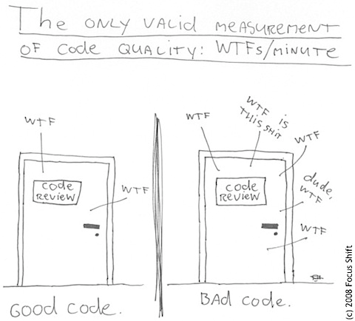
Code Review

Slide 19
Organizing Code Review
Formal CR
Informal CR
Coding time reviewing
Pair programming
Code testing with code inspections
Keep it integrated
Notes:
Problemi formalnog CR-a

Slide 20
What to review?
Newbie's code
Challenging tasks
Spikes
Buggy code
Architecture significant tasks
Widely reused code

Slide 21
Code Review Checklist
Clarity
Maintainability
Accuracy
Security
Scalability
Reusability
OOP principles, encapsulation

Slide 22
Advantages
Two heads are smarter
Collective code ownership
Enhances communication and learning
Discovering bugs/problems early

Slide 23
Potential problems
Consumes time
Focusing on enhancing code rather than criticism
Avoiding general arguments and theoretical discussion
Encouraging positive critics

Slide 24
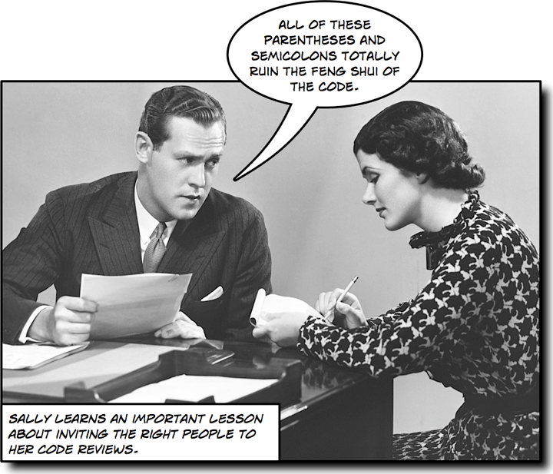

Slide 25
Tools
Code smells
Code Metrics
TFS Support

Slide 26
Summary
Programming is hard
(Clean) Code is very important
Coding Standard is essential tool
Code Review takes time but brings many advantages
Requires firm climate change
Use tools

Slide 27
Questions?
Milan Vukoje
www.vukoje.net
vukoje@gmail.com

Slide 28
Molimo vas da popunite ankete! Please fill out the evaluations!
Vaše mišljenje čini osnovu sledeće Sinergije i omogućava nam da oblikujemo sadržaj u skladu sa Vašim željama.
Svi posetioci koji popune ankete ulaze u nagradnu igru
Your opinion forms the next Sinergija conference, and it provides us with the means to shape its content to best suit you.
All attendees that fill out the evaluations are taking part in drawing of special prizes

